Slide 1

Electives Request
Process for Incoming
7th Graders

Slide 2
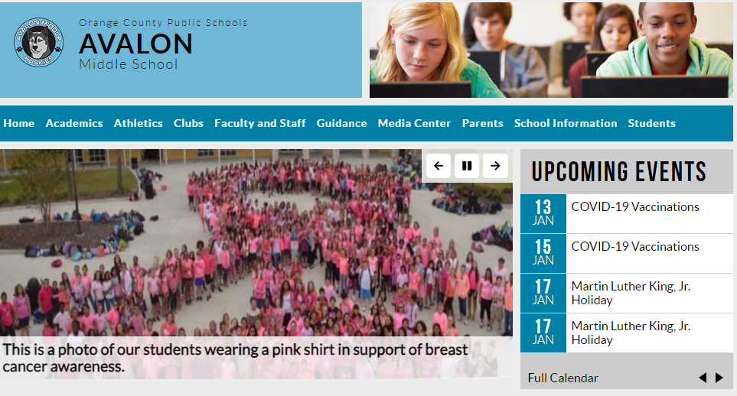
Step 1: Course Guide
View the Course Guide on the AMS website under the Guidance tab.

Slide 3
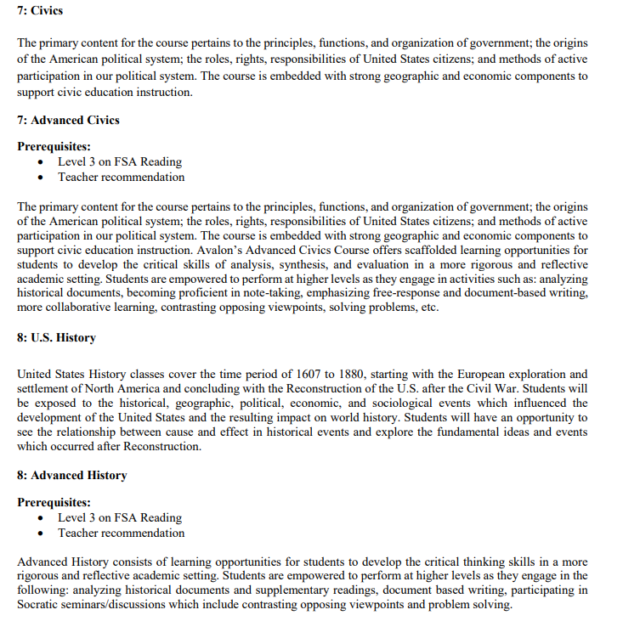
Course Descriptions- Core Classes

Slide 4
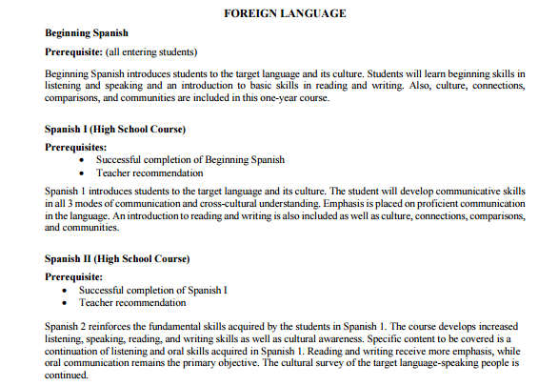
Course Descriptions- Electives

Slide 5
Step 2: Access the Registration Form
Using the link below, access the online registration form to select your elective choices. The link will also be available on our school website. Make sure you access the form for the grade level you will be in next school year.
7th grade: https://tinyurl.com/elec7th
The form can be completed & submitted at home or at school, although we encourage you to discuss your course selection with your parents.

Slide 6
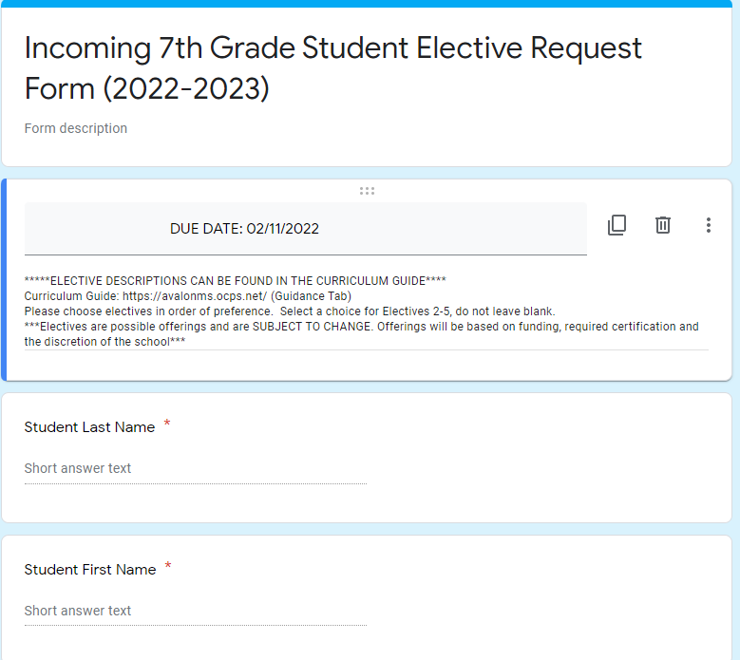
Step 3: Read Important Information Including Due Date

Slide 7
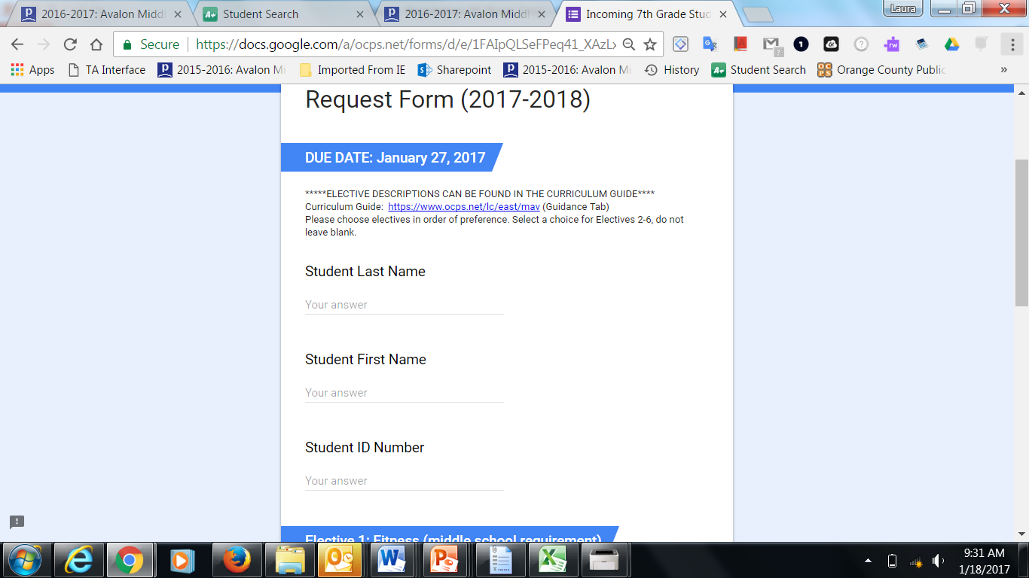
Step 4: Enter Your Information

Slide 8
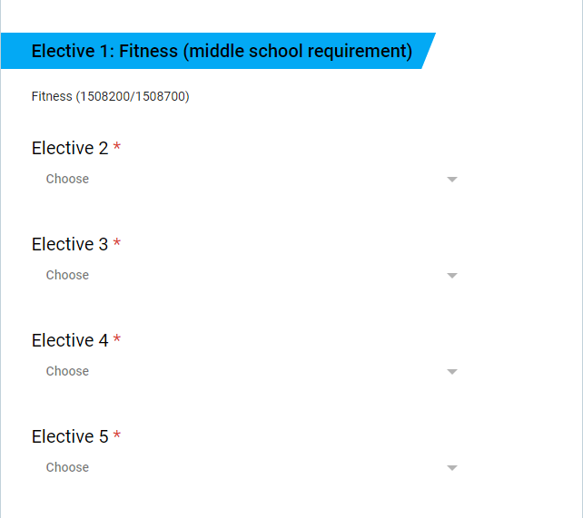
Step 5: Select Your Elective Choices

Slide 9
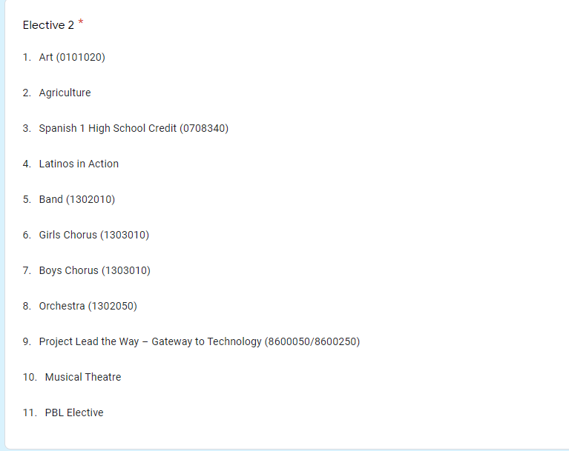
Step 5: Select Your Elective Choices Cont'd

Slide 10
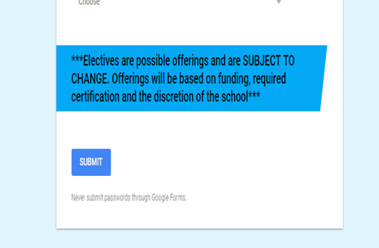
Step 6: When you are done selecting your choices, hit submit

Slide 11
FAQ’s
1. Do I have to specify what Band, Chorus, Orchestra, or Art class I would like to be in?
-No. If you are currently in one of those classes, your teachers will let your counselor know what level you should be registered for.
2. Do I have to take Fitness?
-Yes. Fitness is a requirement for Middle School. See your counselor for more details.
3. Do I need to wait for my parents to do this?
-We encourage you to discuss with your parents what your selections will be so they are aware. This year we will not be doing the paper form, therefore is important that you discuss this with them.
4. What if I change my mind after I complete the form?
-See your grade level counselor.

Slide 12
FAQ
5. What if I do not submit a form?
-If you do not submit a form, your electives will be chosen for you.
6. What if I don’t get my 1st and 2nd pick?
-Please understand that your academics will be selected first and then your electives. Counselors try their very best to honor your 1st or 2nd choice. The other elective will be one of the other ones you listed. This is why is important that you take your time to carefully select your choices. Keep in mind that ELECTIVES offerings are subject to change.
7. Do I have to fill out a form if we are moving?
-Yes, just in case plans change.
8. When do I have to submit the form?
-Forms are due on February 11th, 2022. You may turn it in as soon as you complete it. Make sure your sit with your parents and they are aware of your selections.

Slide 13

Questions????

